Slide 1
Pricing Info Microservice

Slide 2
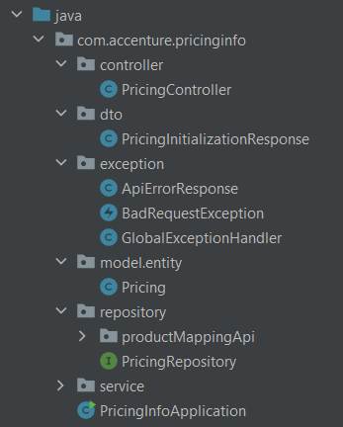
Starter Application
What are the objectives?
A starter application will be provided to kick off your assessment. It includes the following components:
Controller
DTO (Data Transfer Object)
Exception handlers
Pricing Entity
Repository
Service

Slide 3
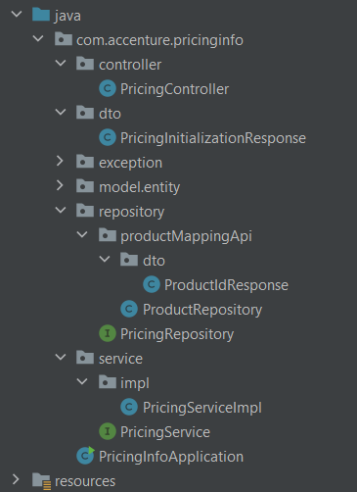
Starter Application
What are the objectives?
Open your own project
PricingController class is a REST controller that provides an endpoint to initialize the pricing database by delegating the task to the PricingService.
PricingInitializationResponse DTOs are typically used for transporting data and do not contain any business logic. They are often used in APIs to define the data structure that is exposed to the client.
Pricing An entity class is mapped to a database table, where the class's fields represent the columns of the table. PricingRepository Repositories often contain methods that are specific to the domain or the entity they manage, such as findByID. PricingService An interface contains method signatures, which are declarations of methods without any implementation.
PricingServiceImpl is the concrete implementation that contains the business logic for this operation.

Slide 4
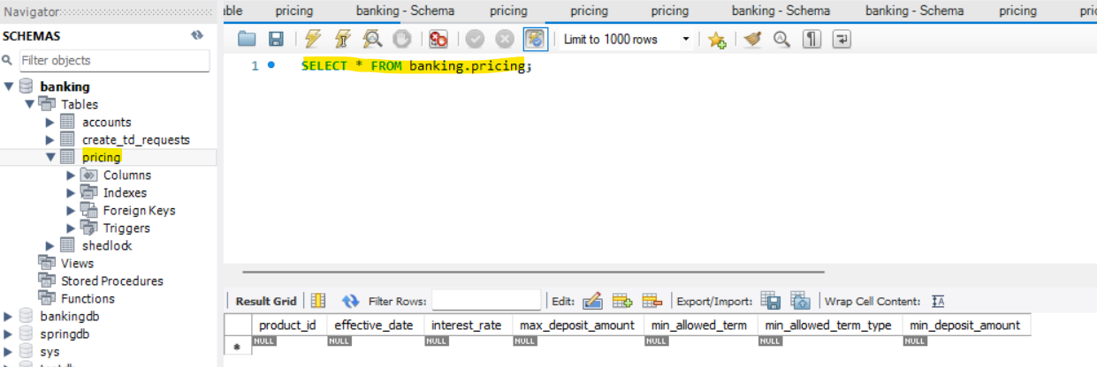
Starter Application
What are the objectives?
Run the application to confirm it is operational and check the console for the following message:
Tomcat has started on port 8084 (http) with the context path ‘/’.
Pricing Table will be created

Slide 5
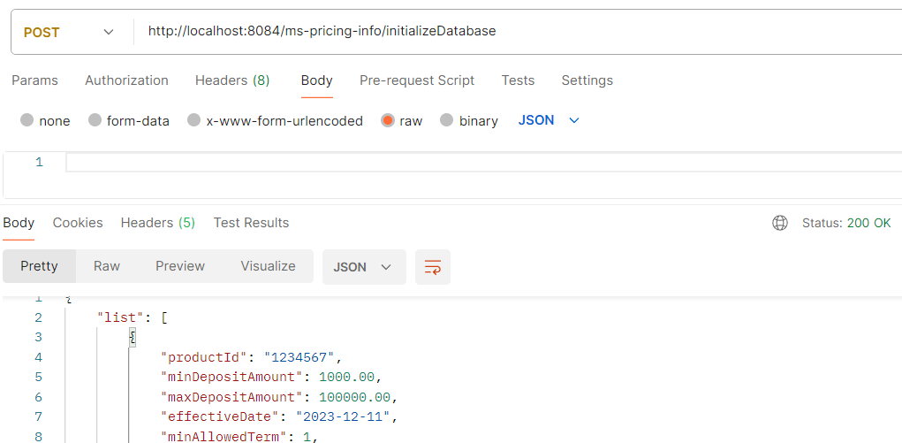
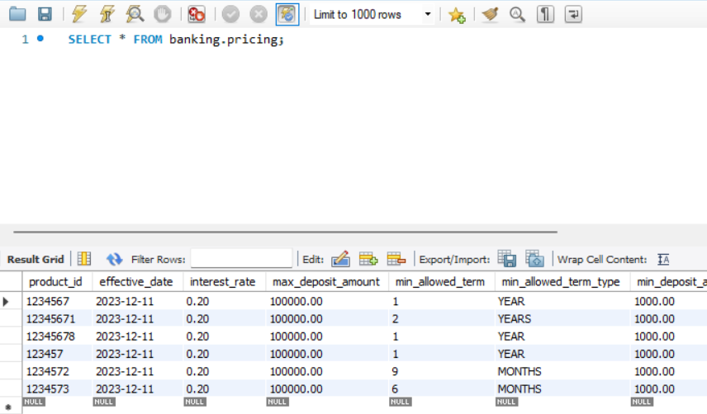
Starter Application
What are the objectives?
Test the initial endpoint: POST http://localhost:8084/ms-pricing-info/initializeDatabase
Pricing table is now populated with records
Postman: Pricing Table:

Slide 6
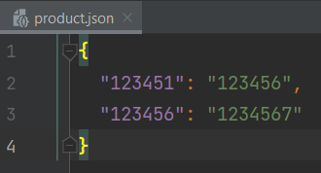
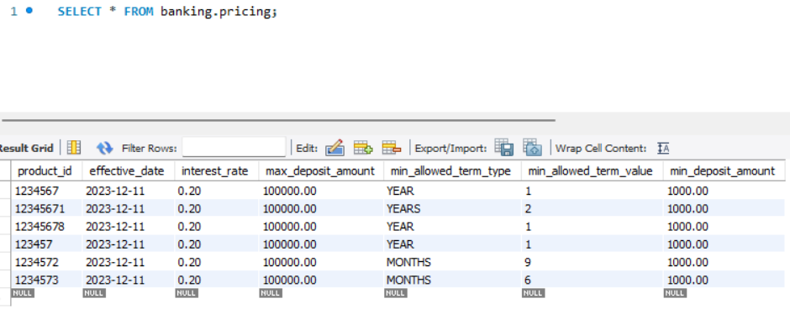
What are the objectives?
What are the objectives?
Develop an application that:
Retrieves the pricing details of a product code from the pricing database
Handles missing product code by throwing a BadRequestException with a relevant error message.
Handles missing pricing details for a particular product code by throwing a BadRequestException with a relevant error message.
Validates the pricing details.
Handles missing product id by throwing a BadRequestException with a relevant error message.
Handles incorrect interest rate.
Handles incorrect term input.
Product Code
Product Id
Pricing Database

Slide 7
Pricing Info Microservice: Get Pricing
What are the objectives?

Slide 8
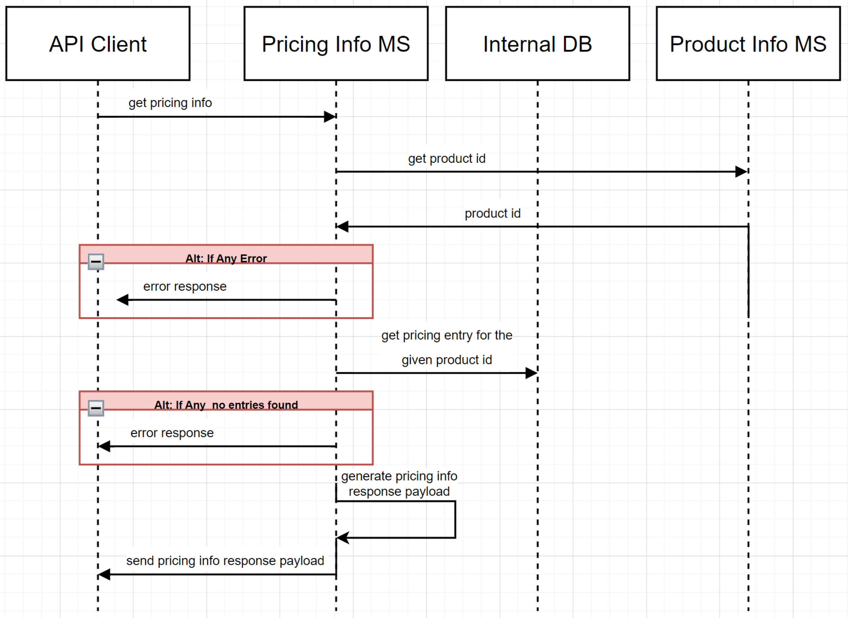
Sequence Diagram – Get Pricing
What are the objectives?
A sequence diagram in UML (Unified Modeling Language) is a type of interaction diagram that shows how objects interact in a particular scenario of a use case.
It emphasizes the sequence of messages exchanged between objects over time.
The API client (Postman) requests the pricing information from the Pricing Info Microservice using a product code. The Pricing Info Microservice, in turn, calls the Product Info Microservice to retrieve the product ID associated with that product code.
If the product code or corresponding product ID does not exist for a given product code, an error is returned.
If the product code is valid, the service responds with the pricing details.

Slide 9
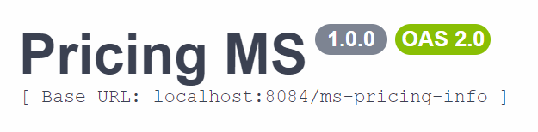
Swagger: Base URL
What are the objectives?
in a Spring Boot application, the base URL is typically specified using the @RequestMapping annotation at the class level.
This sets a common prefix for all the endpoint mappings within that controller class making it easier to manage and organize your API routes.
Base URL Declaration:
The @RequestMapping("/ms-pricing-info") at the class level sets the base URL for all endpoints within the PricingController.
This means that all endpoints in this controller will start with /ms-pricing-info, resulting in the full base URL localhost:8084/ms-pricing-info.

Slide 10
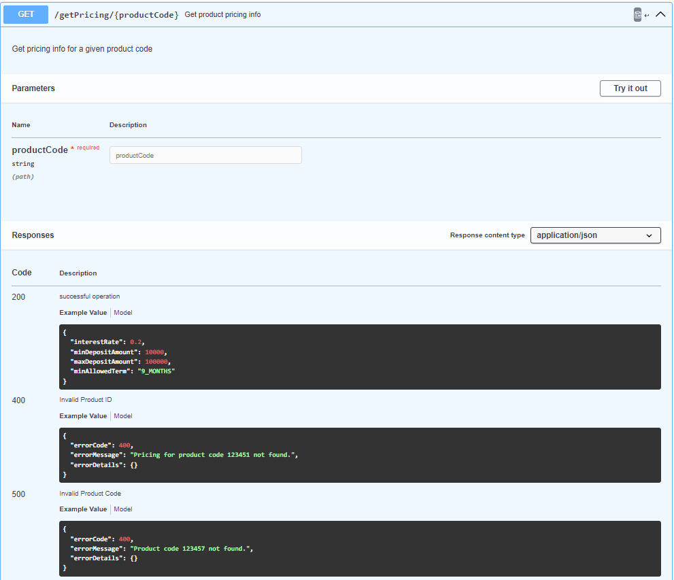
Endpoints
What are the objectives?
In the context of Spring Boot or RESTful web services, an endpoint is a specific URL that a client can use to interact with the server. Each endpoint in a RESTful service corresponds to a particular resource or action that the service provides.
An endpoint in Spring Boot is a URL that maps to a method in a controller class. This URL is used to perform operations such as retrieving, creating, updating, or deleting resources.
Base URL: /ms-pricing-info (defined at the class level).
Endpoint URL: /getPricing/{productCode} (defined at the method level).
Function: Retrieves the pricing details for a specific product ID based on the product code provided in the URL path.

Slide 11
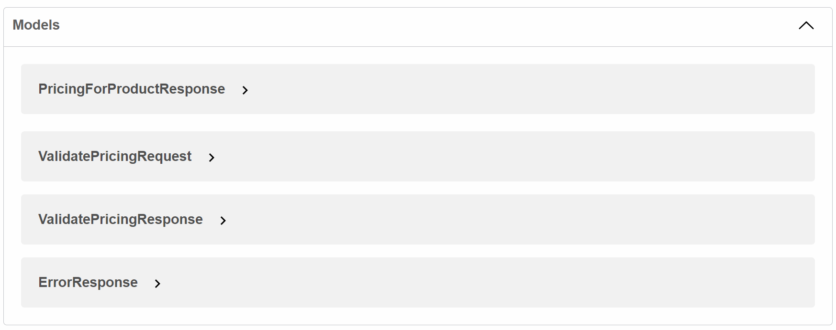
Models
What are the objectives?
Models refer to the data structures that represent the format of the data exchanged between the client and the server. They define how data is structured and validated within your application.

Slide 12
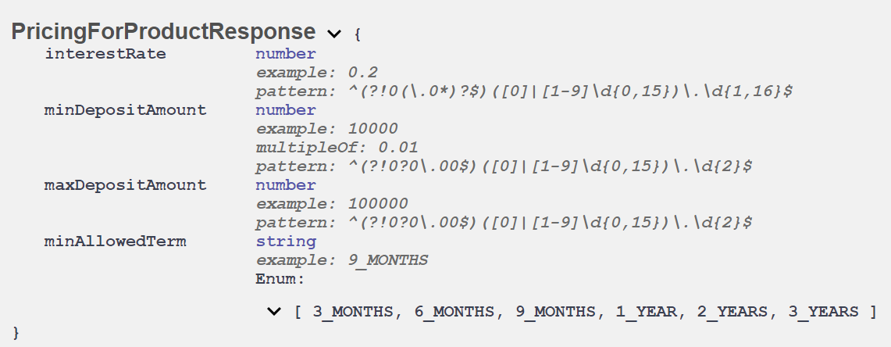
Models
What are the objectives?
PricingForProductResponse is a model used to define the structure of the response that the server sends back to the client when a request is made.

Slide 13
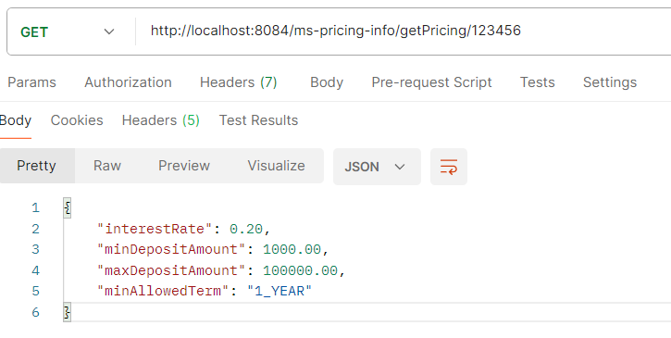
How to test?
What are the objectives?
To test the endpoints using Postman, open the Postman application and create a new request.
Set the appropriate request method (such as GET, POST, PUT, or DELETE) and enter the correct URL for the endpoint you want to test.
Click "Send" to make the request, and then review the response in Postman to check if it matches your expectations. This allows you to verify that your API endpoints are functioning correctly.
Valid scenario: GET http://localhost:8084/ms-pricing-info/getPricing/123456

Slide 14
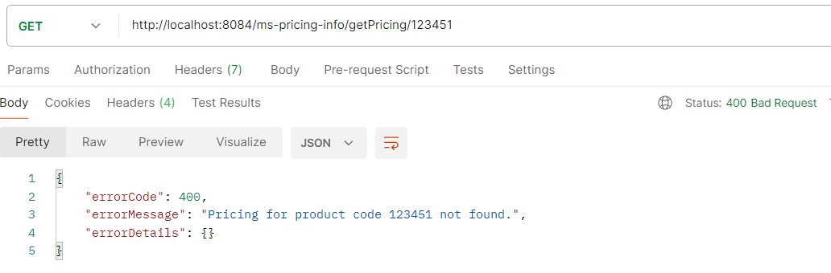
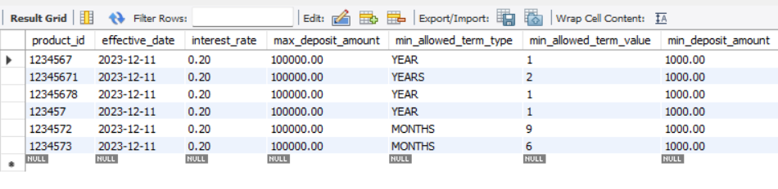
How to test?
What are the objectives?
Invalid Product Code: GET http://localhost:8082/ms-product-info/getProductId/12345
Product Code Found!
Product ID NOT Found!

Slide 15
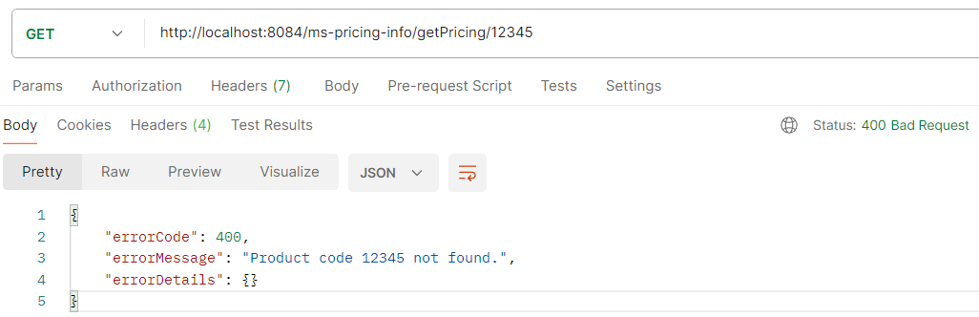
How to test?
What are the objectives?
Invalid Product Code: GET http://localhost:8082/ms-product-info/getProductId/12345
Ensure that the status code returned in Postman matches the expected status code for your request.
This confirms that the response from the server aligns with the expected outcome for the scenario being tested."

Slide 16
Unit Test
What are the objectives?
Location: Create the unit test class under the test folder in your project directory.
Package Name: The package name of the test class should match the package name of the class you are testing. For example, if the PricingServiceImpl class is located in the package com.accenture.pricinginfo.service.impl, then the test class should also be in com.accenture.pricinginfo.service.impl.
Class Name: Name the test class PricingServiceImplTest to clearly indicate that it tests the PricingServiceImpl class.

Slide 17
Unit Test
What are the objectives?
Test Method Name | Method to Test | Description | Test Condition | Expected Result
testGetPricing_ValidProductCodeAndValidProductId | PricingServiceImpl.getPricing | Retrieving the pricing for a valid product code and a valid product ID. | Call PricingServiceImpl.getPricing("123456") | Verify that the returned data includes the following interestRate: 0.2 minDepositAmount: 1000.00 maxDepositAmount: 100,000.00 minAllowedTerm: "1_YEAR"
testGetPricing_ValidProductCodeButInvalidProductId | PricingServiceImpl.getPricing | Retrieving the pricing for a valid product code but an invalid product ID should result in an error response. | Call PricingServiceImpl.getPricing("123451") | Verify that the returned data includes the following: errorId: 400 errorMessage: "Pricing for product code 123451 not found." errorDetails of an empty map.
testGetPricing_InvalidProductCode | PricingServiceImpl.getPricing | Attempting to retrieve pricing for an invalid product code should return an error response. | Call PricingServiceImpl.getPricing("12345") | Verify that the returned data includes the following: errorId: 400 errorMessage: "Product code 12345 not found." errorDetails of an empty map.

Slide 18
Pricing Info Microservice: Validate Pricing
What are the objectives?

Slide 19
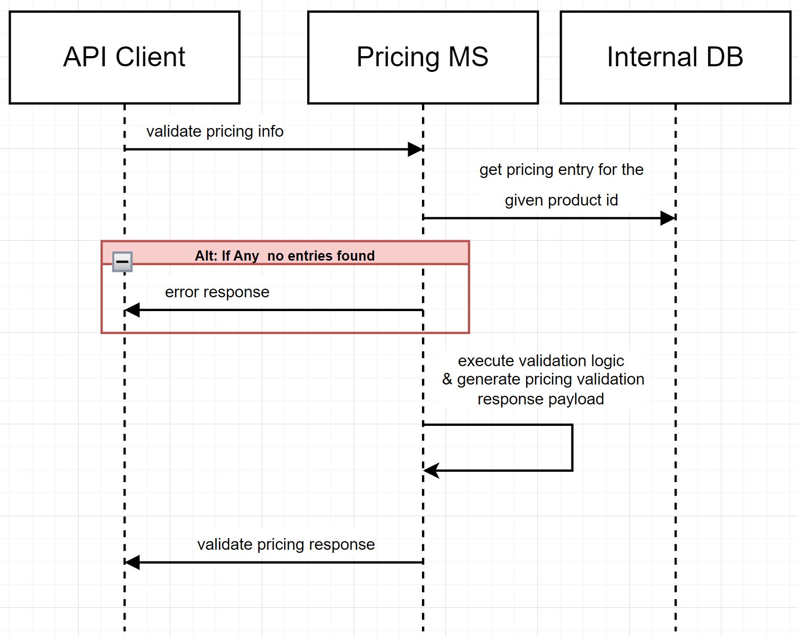
Sequence Diagram – Validate Pricing
What are the objectives?
A sequence diagram in UML (Unified Modeling Language) is a type of interaction diagram that shows how objects interact in a particular scenario of a use case.
It emphasizes the sequence of messages exchanged between objects over time.
The API client (Postman) validates the pricing information from the Pricing Info Microservice by sending a JSON payload. The Pricing Info Microservice then verifies the existence of the data in its database.
If the product ID does not exist, an error is returned.
If either the term or interest rate is validated and found to be invalid, an error message is returned.
If the product ID exists in the database, no error will be returned.
*A payload refers to the actual data that is being transmitted in a request or response, typically in APIs.

Slide 20
Swagger: Base URL
What are the objectives?
in a Spring Boot application, the base URL is typically specified using the @RequestMapping annotation at the class level.
This sets a common prefix for all the endpoint mappings within that controller class making it easier to manage and organize your API routes.
Base URL Declaration:
The @RequestMapping("/ms-pricing-info") at the class level sets the base URL for all endpoints within the PricingController.
This means that all endpoints in this controller will start with /ms-pricing-info, resulting in the full base URL localhost:8084/ms-pricing-info.

Slide 21
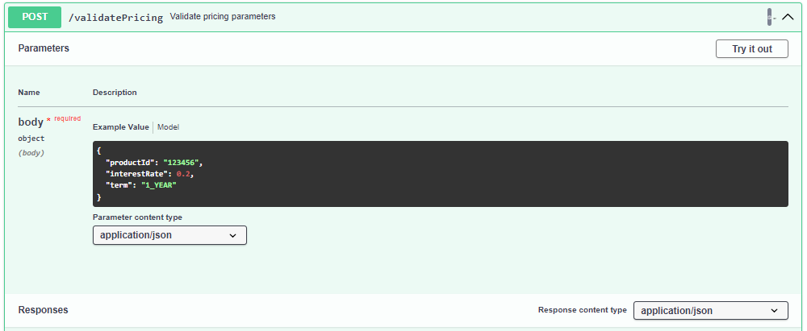
Endpoints
What are the objectives?
In the context of Spring Boot or RESTful web services, an endpoint is a specific URL that a client can use to interact with the server. Each endpoint in a RESTful service corresponds to a particular resource or action that the service provides.
An endpoint in Spring Boot is a URL that maps to a method in a controller class. This URL is used to perform operations such as retrieving, creating, updating, or deleting resources.
Base URL: /ms-pricing-info (defined at the class level).
Endpoint URL: /validatePricing
(defined at the method level).
Function: Retrieves the pricing details for a specific product ID based on the product code provided in the URL path.

Slide 22
Models
What are the objectives?
Models refer to the data structures that represent the format of the data exchanged between the client and the server. They define how data is structured and validated within your application.

Slide 23
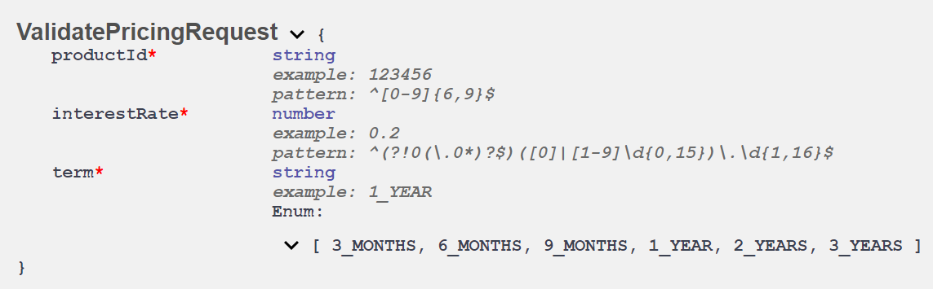
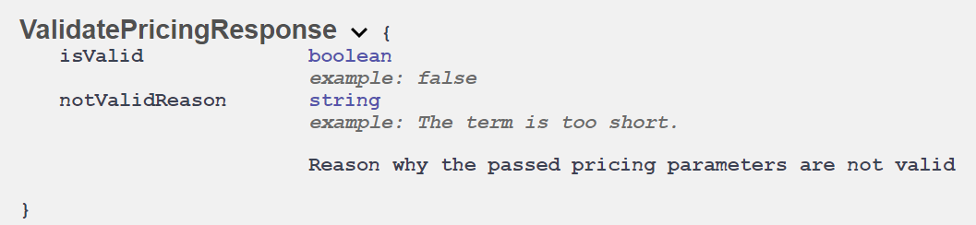
Models
What are the objectives?
ValidatePricingRequest is a model that defines the structure of the request sent by the client ValidatePricingResponse is a model that defines the structure of the response sent back to the client after a request is processed.

Slide 24
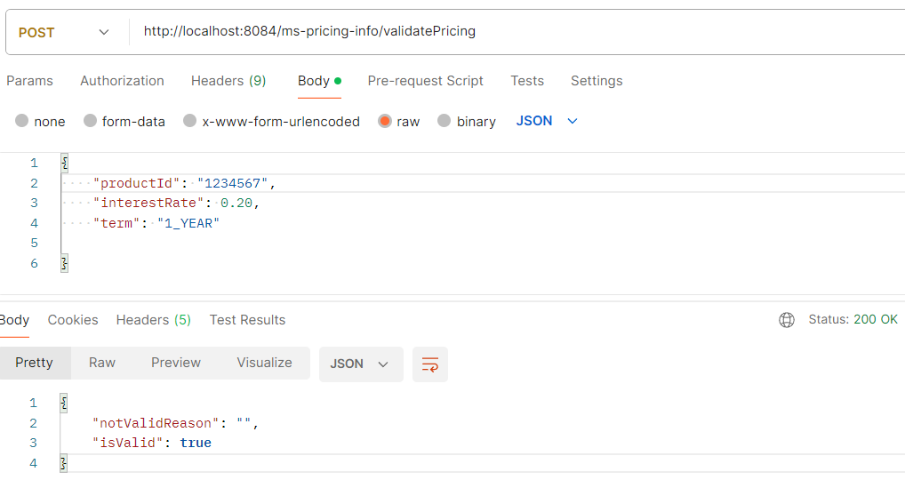
How to test?
What are the objectives?
To test the endpoints using Postman, open the Postman application and create a new request.
Set the appropriate request method (such as GET, POST, PUT, or DELETE) and enter the correct URL for the endpoint you want to test.
Click "Send" to make the request, and then review the response in Postman to check if it matches your expectations. This allows you to verify that your API endpoints are functioning correctly.
Valid scenario: POST http://localhost:8084/ms-pricing-info/validatePricing

Slide 25
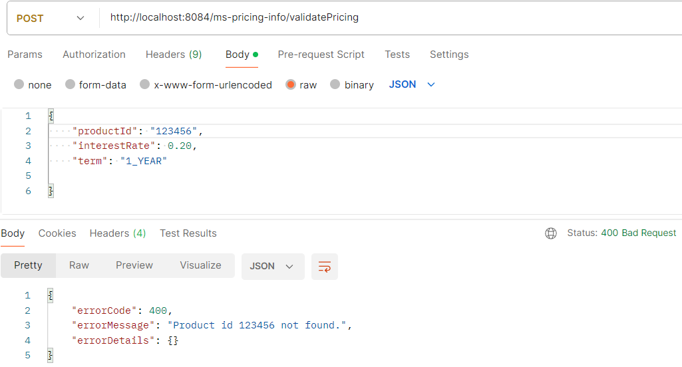
How to test?
What are the objectives?
Invalid Product Id: POST http://localhost:8084/ms-pricing-info/validatePricing
Product Code Found!
Product IdNOT Found!

Slide 26
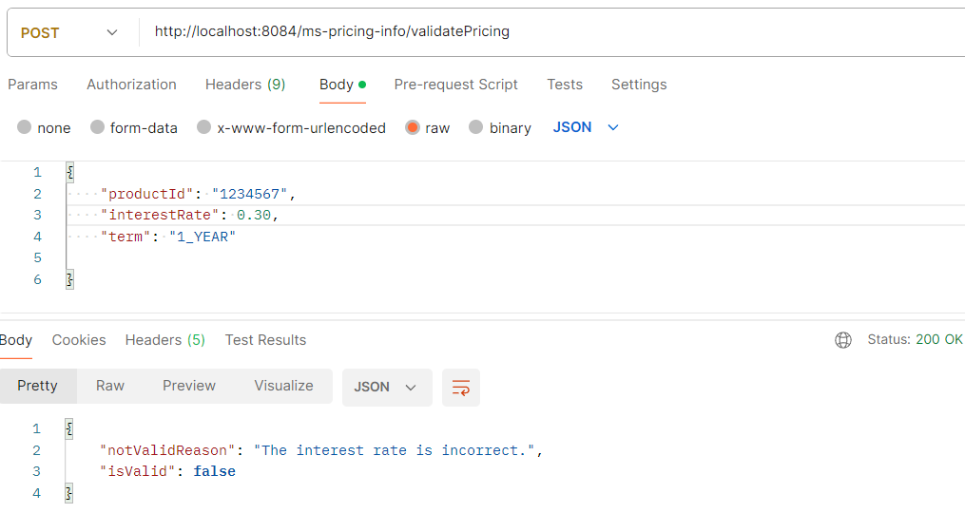
How to test?
What are the objectives?
Invalid Interest Rate: POST http://localhost:8084/ms-pricing-info/validatePricing
Product Id Found BUT Invalid Interest Rate!

Slide 27
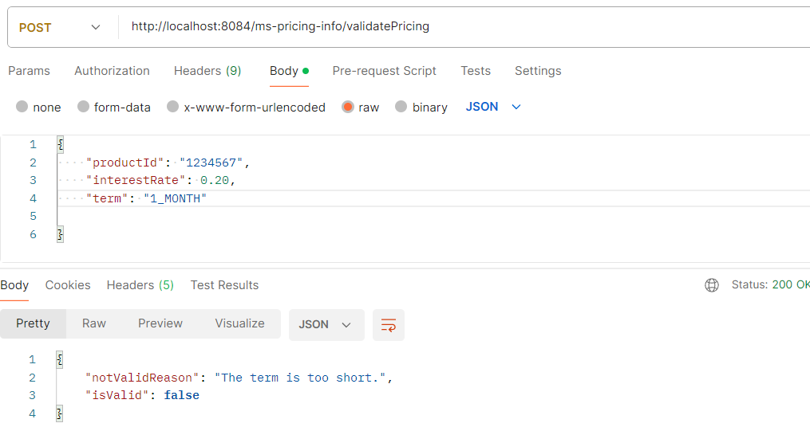
How to test?
What are the objectives?
Invalid Term: POST http://localhost:8084/ms-pricing-info/validatePricing
Product Id Found BUT Invalid Term!

Slide 28
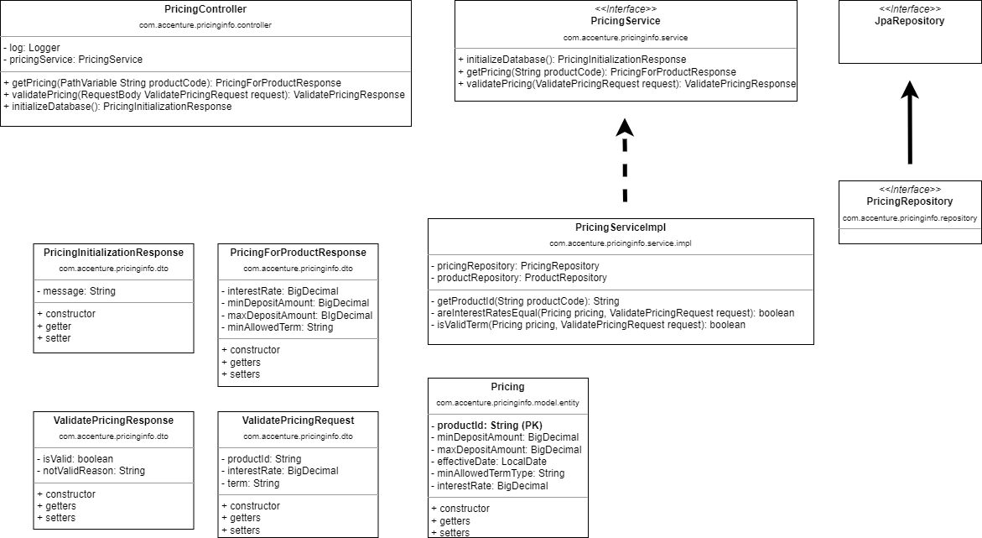
Class Diagram
What are the objectives?
The getProductId method should be called by the getPricing method
The areInterestRatesEqual and isValidTerm method should be called by the validatePricing method
PK - primary key

Slide 29
Unit Test
What are the objectives?
Location: Create the unit test class under the test folder in your project directory.
Package Name: The package name of the test class should match the package name of the class you are testing. For example, if the PricingServiceImpl class is located in the package com.accenture.pricinginfo.service.impl, then the test class should also be in com.accenture.pricinginfo.service.impl.
Class Name: Name the test class PricingServiceImplTest to clearly indicate that it tests the PricingServiceImpl class.

Slide 30
Unit Test
What are the objectives?
Test Method Name | Method to Test | Description | Test Condition | Expected Result
testValidatePricing_CorrectDetails | PricingServiceImpl.validatePricing | Validate a pricing with correct details should return a ValidatePricingResponse. Correct details: product id, interest rate, and term | Call PricingServiceImpl.validatePricing request = { productId: "1234567", interestRate: 0.2, term: "1_YEAR" } | Verify that the returned data includes the following notValidReason: "" isValid: true
testValidatePricing_InvalidProductId | PricingServiceImpl.validatePricing | Validate a pricing with an invalid product id should return a BadRequestException. | Call PricingServiceImpl.validatePricing request = { productId: "1234567", interestRate: 0.2, term: "1_YEAR" } | Verify that the returned data includes the following: errorId: 400 errorMessage: "Pricing for product code 123456 not found." errorDetails of an empty map.
testValidatePricing_ValidProductIdButInvalidInterestRate | PricingServiceImpl.validatePricing | Validate a pricing with a valid product id, but with an invalid interest rate. | Call PricingServiceImpl.validatePricing request = { productId: "1234567", interestRate: 0.3, term: "1_YEAR" } | Verify that the returned data includes the following: notValidReason: "The interest rate is incorrect." isValid: false
testValidatePricing_ValidProductIdButInvalidTerm | PricingServiceImpl.validatePricing | Validate a pricing with a valid product id, but with an invalid interest rate. | Call PricingServiceImpl.validatePricing request = { productId: "1234567", interestRate: 0.2, term: "1_MONTH" } | Verify that the returned data includes the following: notValidReason: "The term is too short." isValid: false

Slide 31
FAQ – Frequently Asked Questions
An error was encountered : org/springframework/boot/SpringApplication has been compiled by a more recent version of the Java Runtime (class file version 61.0), this version of the Java Runtime only recognizes class file versions up to 55.0
About the error: The error indicates that your project is using a version of Spring Boot compiled with a newer version of Java than the one you are currently using. To resolve this, you need to update your Java version to match the version used by Spring Boot.
Solution:
Check the required Java version for your Spring Boot version: Spring Boot 2.5.x requires Java 11, while Spring Boot 3.x requires Java 17.
Update your Java Development Kit (JDK): Ensure you have the correct JDK installed. You can download the latest JDK from Downloads for Amazon Corretto 17 - Amazon Corretto 17
Update your IDE settings: Ensure IntelliJ IDEA is configured to use the correct JDK.
Step 1:
Go to File > Project Structure.
Under Project Settings, select Project.
Set the Project SDK to the correct JDK version.
Set the Project language level to the corresponding Java version.
After making these changes, rebuild your project to ensure it uses the correct Java version.
Step 2:
Verify if the Run Configuration uses the correct JDK:
Click on Run > Edit Configurations. Under Build and Run, select the appropriate JDK.
Update your pom.xml: Ensure your Maven project is configured to use the correct Java version.
Can I use Github Copilot? Yes, you can use GitHub Copilot. It will help you accelerate your development process during the bootcamp.
Access denied for user 'root'@'localhost' (using password: YES) - update spring.datasource.password

Slide 32
Guidance for your Demo
A proper demo goes beyond just executing requests in Postman.
Clear Explanation: Start by clearly explaining the purpose of the demo. Describe the endpoint you're testing, the scenario, and what you expect to show. Scenario: For this demonstration, I will use a product code 12345 that does not exist in our JSON file. This will help us see how the API handles requests for non-existent products.
Expectation: We expect the API to return a 400 Bad Request status code with a detailed error message indicating that the product code was not found. This will show us how the system handles errors and provides feedback when the requested product is not available."
You can demonstrate the endpoints as soon as you have created them. JUnit tests can be demonstrated afterwards.

